Slide 1
Ensemble Methods - Boosting
a bold adventure

Slide 2
From Bagging to Boosting
Bootstrap AGGregatING - reducing variance in the bias-variance tradeoff
Decision trees change drastically based on training data
Combining decision tree predictions lowers the variance of the overall ensemble model
Overall model changes less drastically based on different training data -> better predictions
Boosting - combining weak learners into a strong learner by iteratively changing training data of aggregated trees

Slide 3
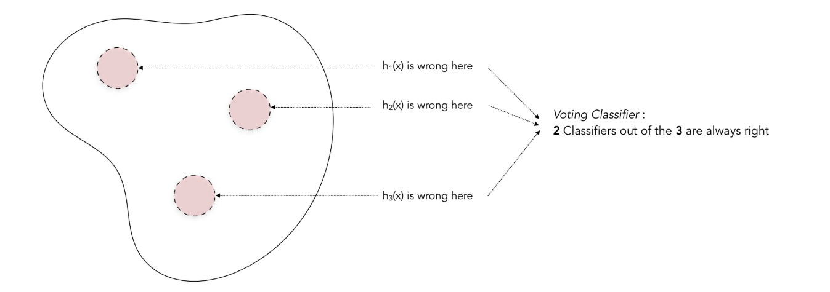
From Bagging to Boosting
What problem with bagging does boosting mitigate?
Set of bagged predictions

Slide 4
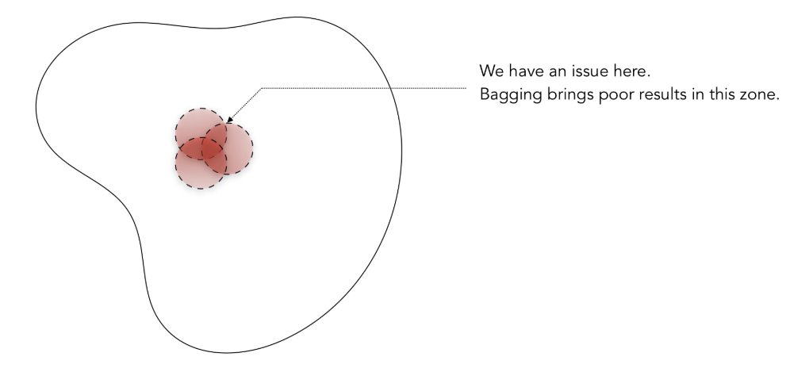
From Bagging to Boosting
What problem with bagging does boosting mitigate?
Set of bagged predictions

Slide 5
ADAptive BOOSTing
After growing each tree:
find mis-classified observations
alter the weight of data based on which obs were mis-classified
grow another tree based off of re-weighted data
combine all trees to create an ensemble model

Slide 6
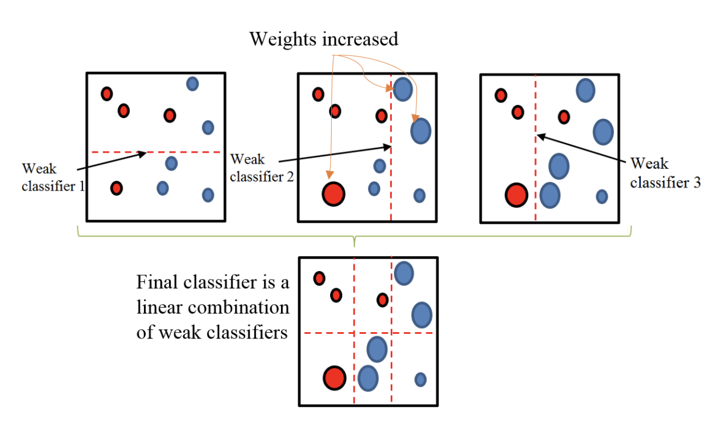
ADAptive BOOSTing

Slide 7
ADAptive BOOSTing
Trees grown are usually very very bad predictors on their own
Commonly, only 1 split (a “stump”)
Want to update weights slowly, and so want to use incredibly weak learners at each step

Slide 8
ADAptive BOOSTing
How do the iteratively-updated weights on the data affect the growing of the trees? Different implementations:
Adaboost could implement a bootstrap sampling method for each tree. If so, weights are likelihood of obs to be selected in sample for tree
Data which is “hard” more likely to show up in sample
If all data used for each tree: weights contribute to determining best splits in growing a tree
Split calculation weighted toward data that’s “hard”

Slide 9
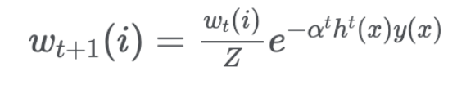
ADAptive BOOSTing
Popular computation of weights:
𝛂^{t} is learning rate
h^{t}(x) is previous model’s prediction
y(x) is actual value
Z is a scalar to make the weights sum to 1
w_{t}(i) is previous weight

Slide 10
ADAptive BOOSTing
How are the grown trees aggregated? Different implementations:
Strict combination of decision boundaries created by each tree (majority vote / strict average)
Weighted combination of each tree (weighted vote / weighted average)

Slide 11
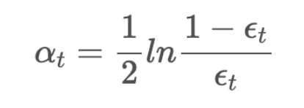
ADAptive BOOSTing
Popular computation of tree weights
ε_{t} is error of tree

Slide 12
ADAptive BOOSTing
SKlearn hyperparams:
base algo to use
decision tree classifier, depth is variable
number of trees to grow
learning rate for combining trees
SAMME (calculations use class predictions) vs. SAMME.R (calculations use probability predictions)
paper on using trees to produce probabilities here

Slide 13
ADAptive BOOSTing
Concept check:
What problem is boosting designed to mitigate?
How does boosting manipulate data to mitigate that problem?
Is the concept of boosting limited to using decision trees?

Slide 14
Gradient Boosting
“Gradient descent + boosting”

Slide 15
Gradient Boosting
“Gradient descent + boosting”
Build a tree

Slide 16
Gradient Boosting
“Gradient descent + boosting”
Build a tree
Find the residuals of the predictions

Slide 17
Gradient Boosting
“Gradient descent + boosting”
Build a tree
Find the residuals of the predictions
Put the residuals into a cost function

Slide 18
Gradient Boosting
“Gradient descent + boosting”
Build a tree
Find the residuals of the predictions
Put the residuals into a cost function
Calculate the negative gradients

Slide 19
Gradient Boosting
“Gradient descent + boosting”
Build a tree
Find the residuals of the predictions
Put the residuals into a cost function
Calculate the negative gradients
Fit a new tree to the negative gradients

Slide 20
Gradient Boosting
“Gradient descent + boosting”
Build a tree
Find the residuals of the predictions
Put the residuals into a cost function
Calculate the negative gradients
Fit a new tree to the negative gradients
Update the overall model by multiplying the new tree with a learning rate

Slide 21
Gradient Boosting
Sounds like a lot, right?
That process with a MSE loss function . . . is just fitting a new tree on the residuals
Different loss functions require those additional steps, however
Might want to use different loss functions (eg absolute loss, Huber loss) to eg minimize outlier influence in MSE

Slide 22
Gradient Boosting
Wait . . . isn’t MSE used for regression? What about classification?

Slide 23

Gradient Boosting
Wait . . . isn’t MSE used for regression? What about classification?

Slide 24
Gradient Boosting
For classification:
create one model for each class
for each obs:
calculate probability for each class prediction as e^{Fclass(x)}/ Σe^{Fall classes(x)}
cost function is difference between calculated probabilities and actual class value (eg KL divergence)
proceed as above with regression, except each step is taken for each model for each class

Slide 25
Gradient Boosting
Not necessary to know all that (phew!)
If interested, here’s a primer

Slide 26
Gradient Boosting
Sklearn implementation, but XGBoost is the gold standard
Lotsssss of hyperparameters
Since trees are fit on residuals, tendency to overfit
Lots of tuning -> control over overfitting
How trees are grown, loss function, interaction between the two

Slide 27
Boosting Summary
Pros:
Powerful
Relatively fast vs. other high-achieving methods
Since most likely growing small trees, can view the trees to see what model is doing (less of a black box)
Cons:
Lots of hyperparams -> lots of searching -> inc. time
Tendency to overfit if hyperparams not tuned

Slide 28
Boosting Summary
How do we classify a boosting algorithm?

